Slide 1
VSys Voices:
The Value of Volunteer Recognition for Morale
Notes:
Volunteers need to feel valued, not just recognized. This webinar focuses on how to gain their input and trust while also improving engagement and outcomes. Join Dana and Todd as we kick-off the new year with a dynamite presentation!

Slide 2
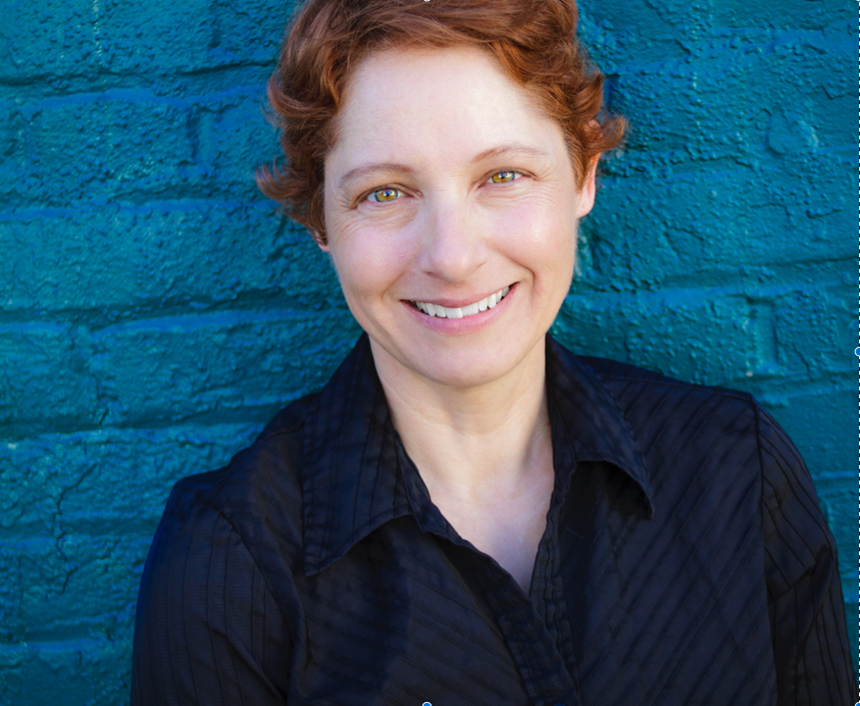
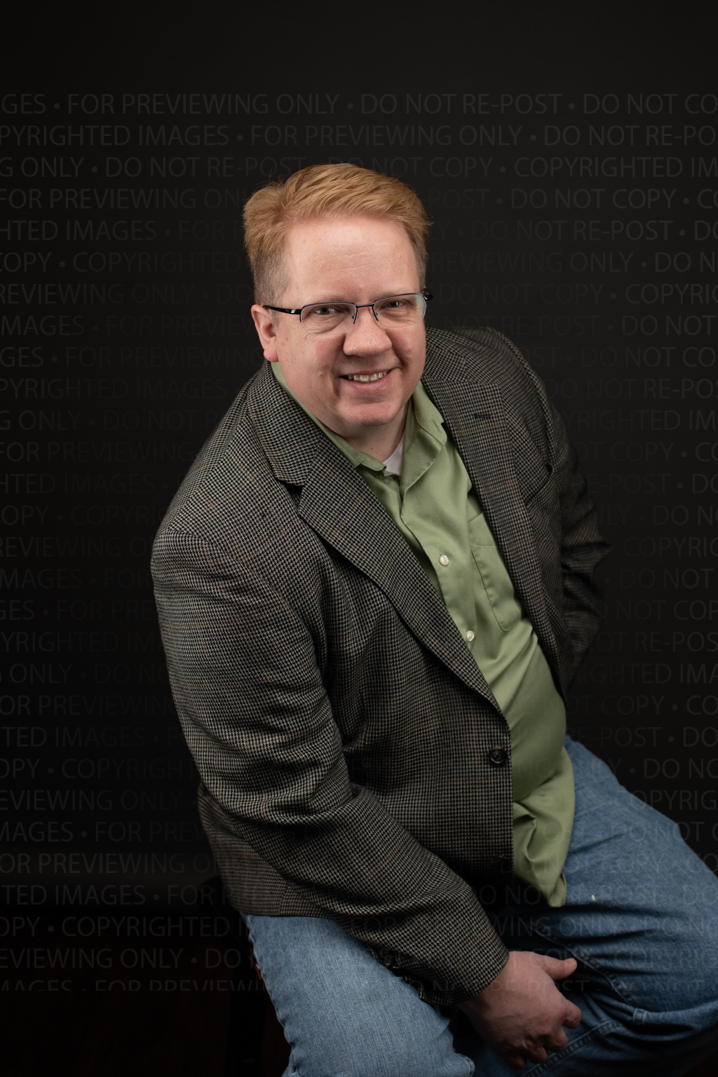
VSys Voices Presenters
Dana Litwin, CVA, is a globally recognized strategic advisor, speaker, and advocate for civic service. Since 2002 she has guided organizations in California's Silicon Valley and nationwide to produce breakthrough volunteer and community engagement programs. Dana is the creator of the YouTube channel “Priceless Advice for Leaders of Volunteers”, served as President of the Association of Leaders in Volunteer Engagement (AL!VE), and is a founder and facilitator of the National Alliance for Volunteer Engagement.
Todd McMullin graduated in non-profit management and has 25 years experience as a technology consultant for community organizations. He is the co-founder of a United Way chapter, a local Volunteer Center, Samaritan Technologies, The Disaster Help Network, The Congress of Volunteer Association Administrators and the Association of Leaders in Volunteer Engagement (AL!VE).
Notes:
Introduction of presenter(s) and MC
Thank you for inviting me to share on today’s topic, and that you to the participants for attending today. We hope that you find the topic useful and applicable to the work you do around volunteerism.

Slide 3
Discussion: What are you doing now for recognition & morale?
Notes:
Answer in chat or Todd can unmute you to talk.

Slide 4
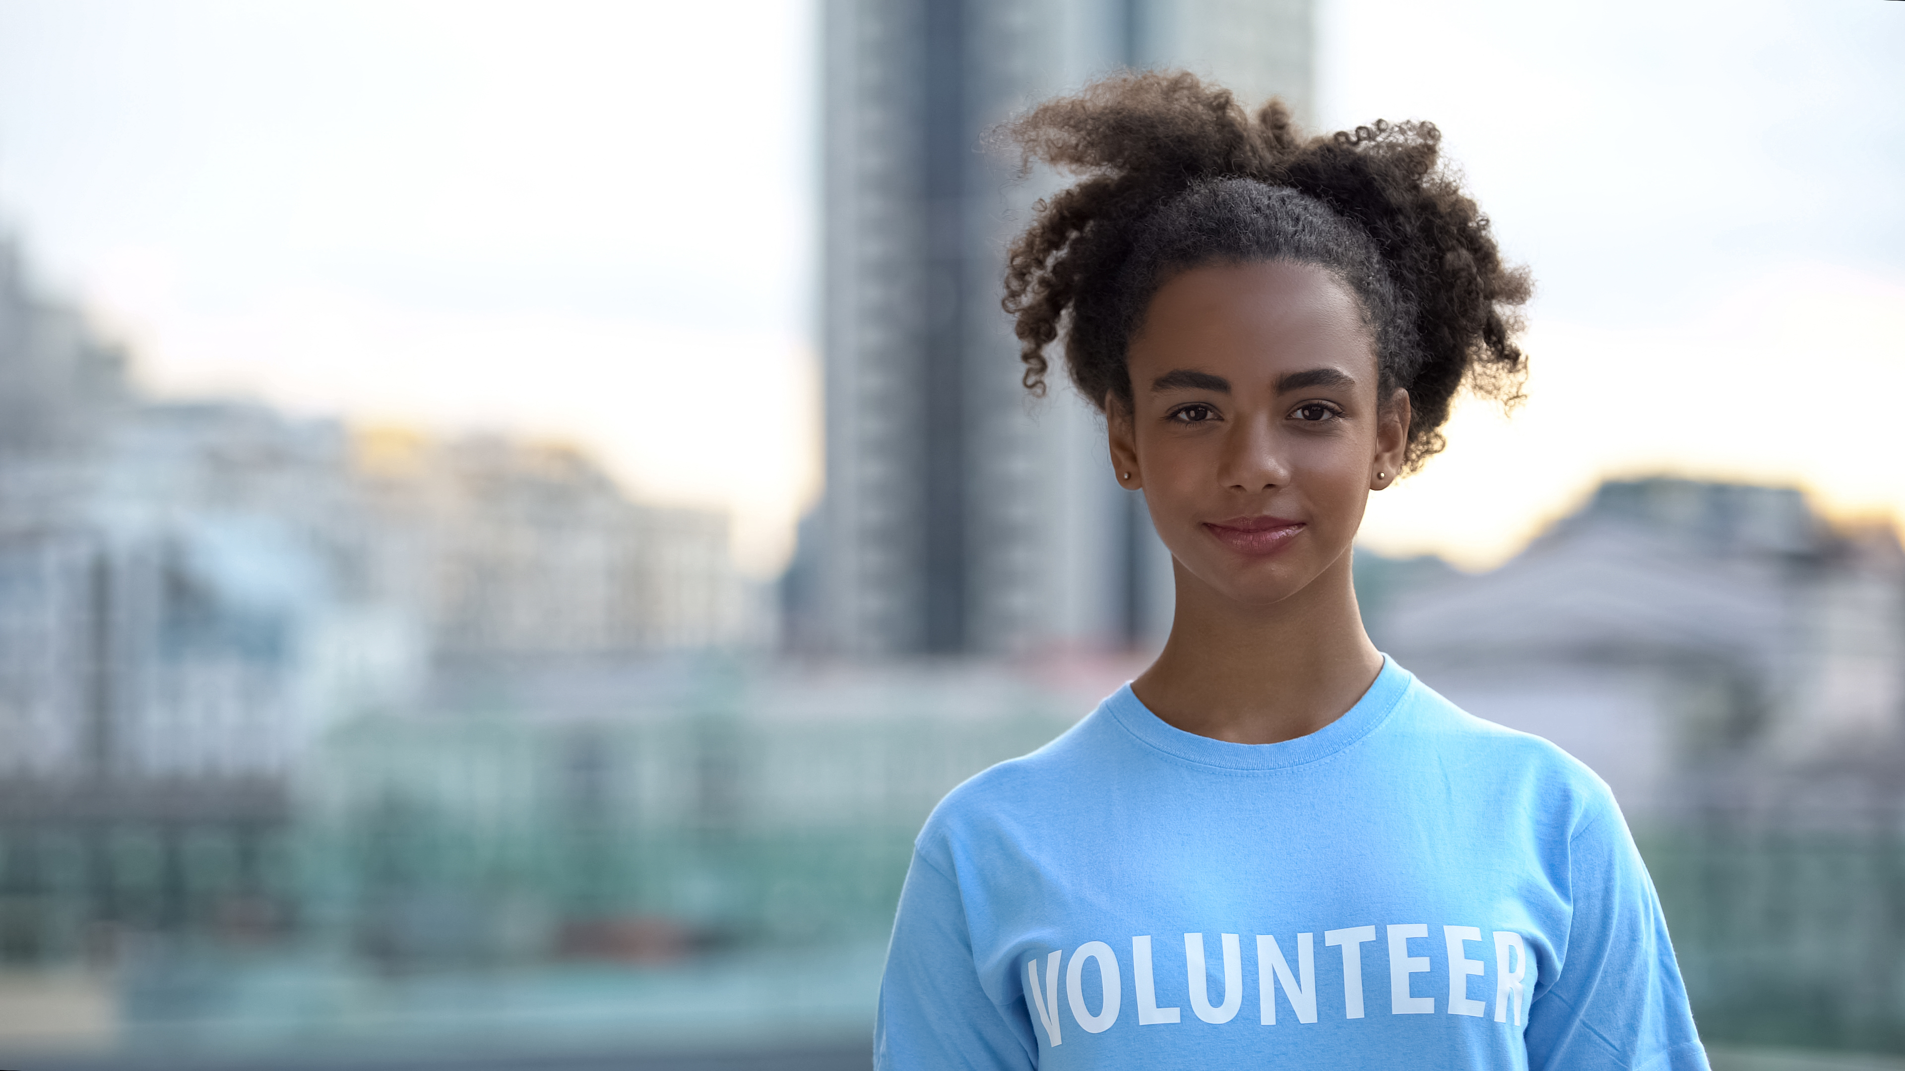
Every Interaction is….
An invitation to stay or an invitation to go!
Notes:
DANA
Every moment and interaction with a potential or current volunteer is a chance for building trust, appreciation, and communicating (recognizing) their value and impact. Smiles are free, saying “Thanks”, and co-creating a culture of mutual respect should be standard behavior for any and all team members engaging volunteers(donors, advocates).

Slide 5

Listen: Everyone Wants to be Heard & Valued
Surveys
Listening Sessions
Chance for honest feedback
Sharing ideas
Ideas to action
Notes:
Performance Reviews or “annual check in”

Slide 6
Why do people volunteer?
Notes:
(Participants answer in chat or unmute to share their volunteer success stories)
People volunteer because they WANT TO! There are as many reasons why they do as there are people on the planet, but the deep down reason is it feels good. Research shows again, and again and again volunteering improves mental and physical health, and generates empathy and stronger social connections. Basic human desires; to belong and to do and feel good.

Slide 7
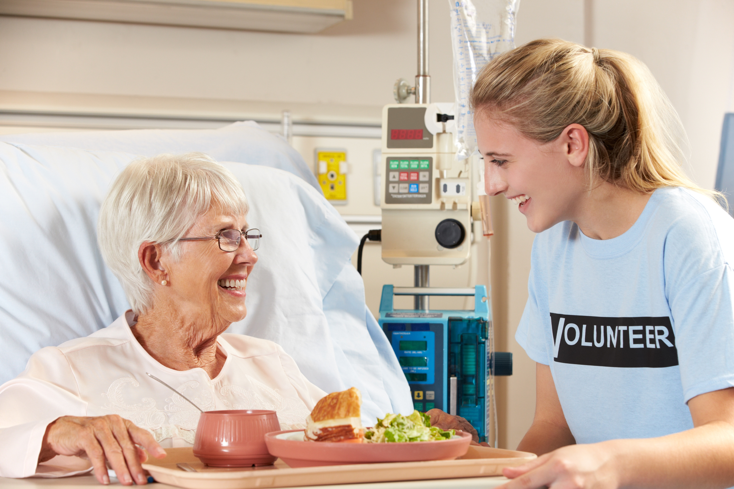
Meaningful & Valuable Impact of Work
Tie to funding; SDOH, grants
Stories of success (emotive)
Volunteer Impacts with Data & Metrics Reports (analytic)
Notes:
TODD
Linking volunteers to the value proposition.
We’ve had previous webinars on data storytelling, aligning funding with Social Determinants of Health and other volunteer impact metrics for internal reporting, and it’s important that volunteers understand how their actions, time, and talent are meaningful to the mission (patients, clients, customers, team, etc)

Slide 8

Shared Goals = Shared Success
How are goals aligned per person, department, etc.?
How is that communicated with volunteers?
Sharing success.
There for each other in tough times.
Show and Tell!
Notes:
Communicating process & progress of plans, projects; Newsletter? Website features?

Slide 9

Build Skills and Leadership
Skills & Learning
Social networking
Resume/Career goals
Leadership
Level up!
Notes:
Many volunteers contribute their time to learn new skills that can help them in their career or job search. By providing your volunteers with skill-building value, you can quickly boost morale. Promoting volunteers is another way to make them feel valued, avoid burnout out, and re-spark motivation. You can promote your best volunteers by providing them with more responsibility or suggesting new opportunities and leadership roles to “level up”. Your belief and trust in their abilities is key!

Slide 10
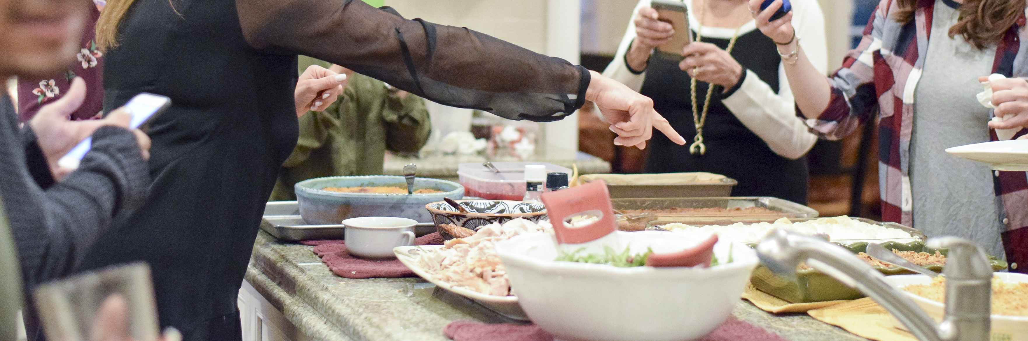
Social Fun & Morale
Notes:
Social morale building (informal events / recognition).
Not everyone wants to be more social, some just want to do their shift and go home, but having the opportunity for “down time” together that is welcoming (not feeling mandatory or like a clique) fosters that sense of belonging, trust, and team morale. Safely having smaller gatherings in person or online just for fun - and not only the “One big yearly party” (that may not work for everyone’s schedules) is a good way to create comraderie.

Slide 11

Gamification
Engagement
Learning
Challenge
Skill
Reward
Achievement
Goals
Organizational Productivity(Increased Capacity)
Notes:
TODD
Gamification!
d. Social morale building (informal events / recognition).

Slide 12
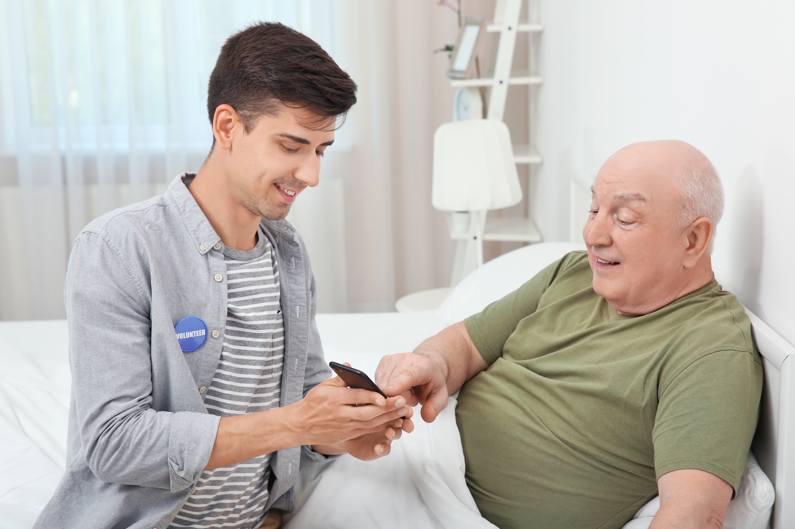

Vision & Inspiration
Notes:
DANA
Think above and beyond volunteers being thanked in the usual ways; cards, social events, gifts, service pins. Those are all fine, but we all know not everyone shows up for an appreciation party; I usually got about 25-50% attendance, and that was pre-pandemic! Passion is contagious, and “interested is interesting”. Tie everything back to a shared vision for the mission, inspiration and trust that you are all in this (the cause, the team, the work) together!

Slide 13
Open Discussion: Brainstorm & Troubleshoot

Slide 14
Thank you for joining us!

